Slide 1
Software Product Management Create business plan – Lean Canvas
Nandagopal Govindan

Slide 2
Contents

Slide 3
Introduction
Once we have assessed an opportunity, it is good to put all our thoughts together on paper.
A detailed business plan covering – problem, solution. USP, market size, revenue generation, etc. needs to be created
A simpler 1-page plan can be created for quick understanding

Slide 4
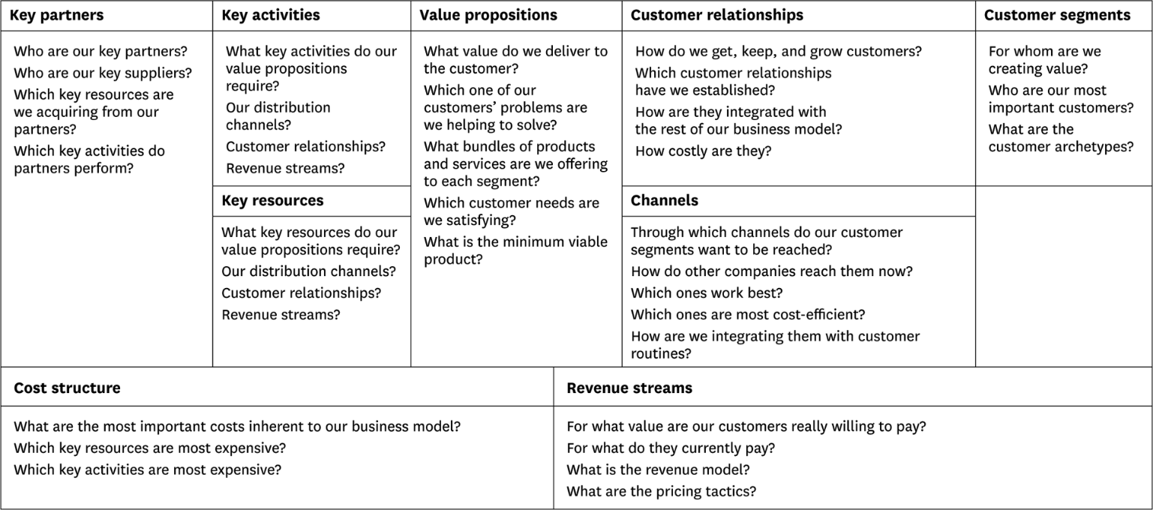
Business Model Canvas by Alexander Ostervald
Ref: www.businessmodelgeneration.com/canvas

Slide 5
Lean canvas – a simplified model
However when are in the early stage, it may not be necessary to go so much into detail, because our product is not yet ready, it has not been validated and many things will change which will yield the model redundant / waste.
Hence a simplified canvas called Lean Canvas is recommended at this early stage. This was proposed by Ash Maurya. Helps get your idea(s) out from your head into a tangible format so that you can communicate that with others

Slide 6
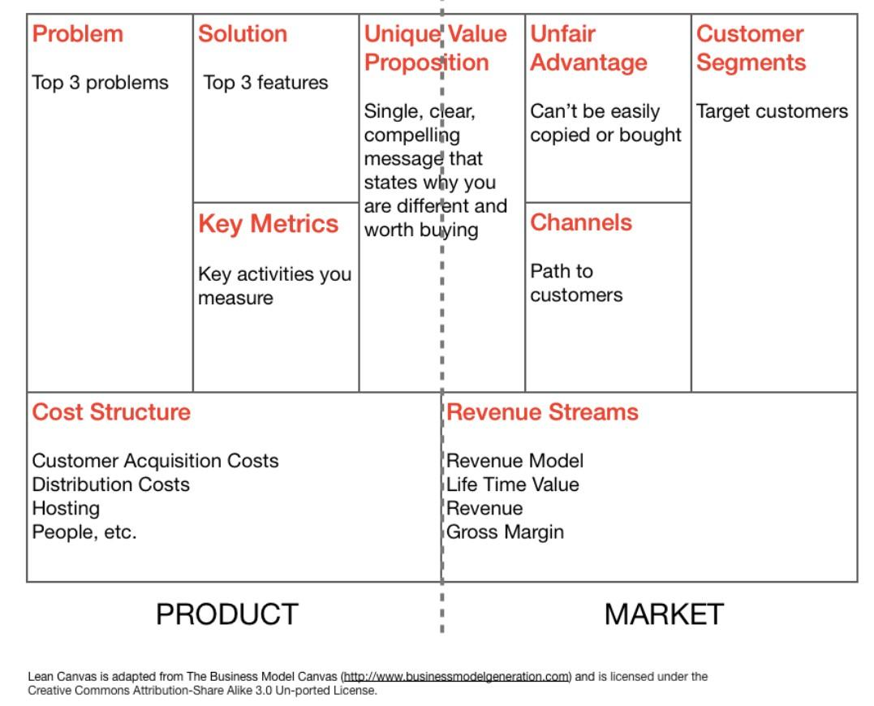
Lean canvas
Ref medium.com

Slide 7
Some explanations
Channels can be email, social, CPC ads, blogs, articles, trade shows, radio & TV, webinars etc.
Metrics can be how many visited, how many signed up, what is the usage, how many continued using
Unfair advantage can be insider information, a dream team, getting expert endorsements, existing customers etc

Slide 8
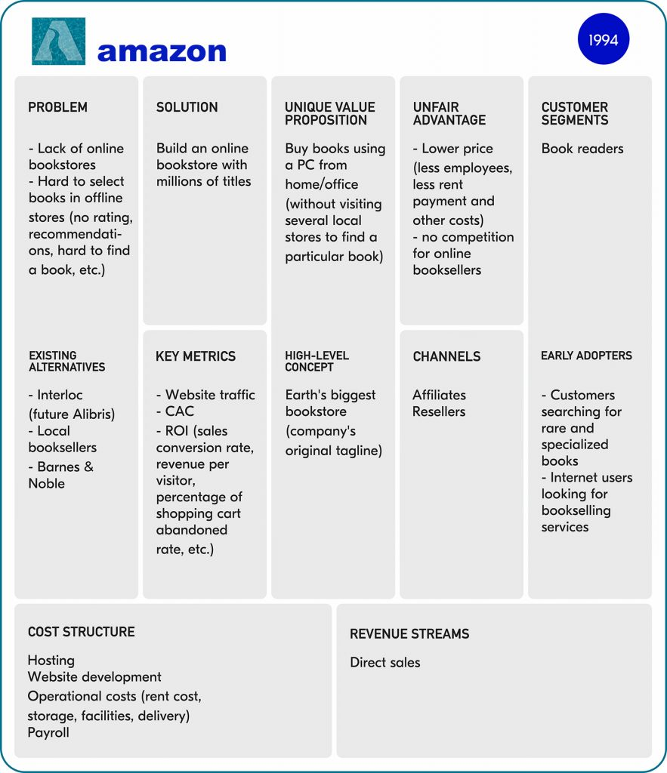

Slide 9
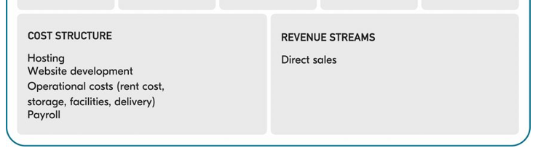
Amazon Lean Canvas…
https://railsware.com/blog/5-lean-canvas-examples/

Slide 10
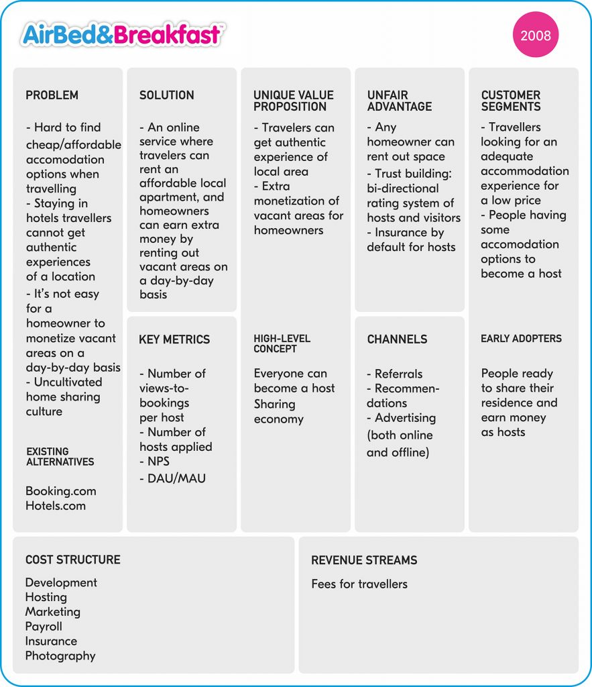

Slide 11
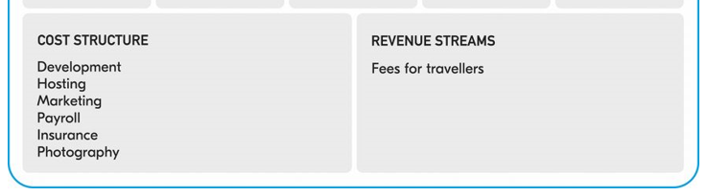
AirBnB Lean Canvas…
https://railsware.com/blog/5-lean-canvas-examples/

Slide 12
Exercise
Create a Lean Canvas for
Rivigo
Qalara

Slide 13
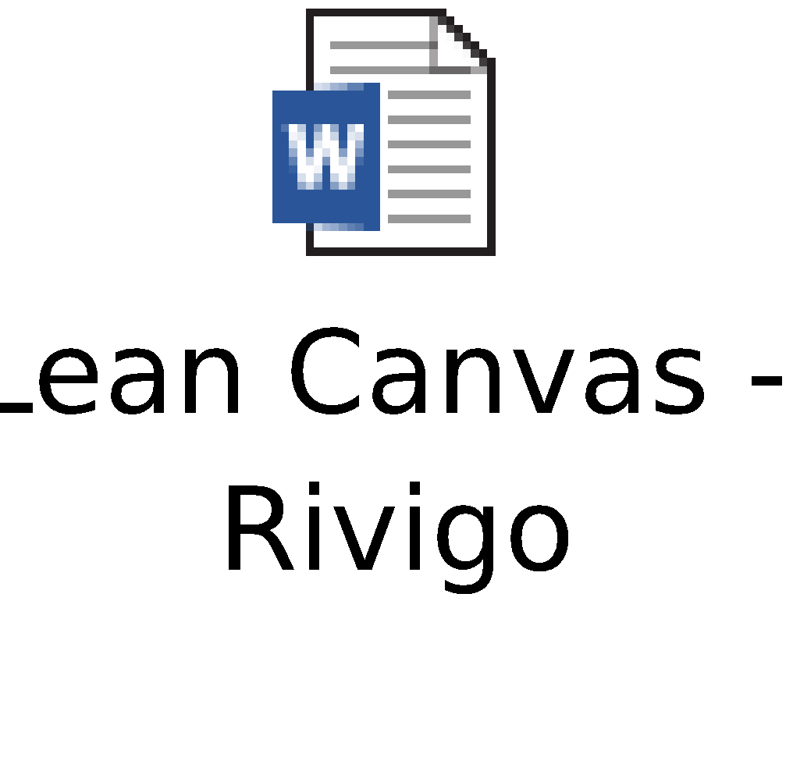
Solution

Slide 14
Appendix

